Slide 1
Presentation for NAAC National Assessment and Accreditation Council
Dr. Sanjay Tanwani
Professor & Head
School of Computer Science & Information Technology
Devi Ahilya Vishwavidyalaya, Indore

Slide 2
Vision & Mission
Vision
Mission
To produce world-class professionals who have excellent analytical skills, communication skills, team building spirit and ability to work in cross cultural environment
To produce international quality IT professionals, who can independently design, develop and implement computer applications
To develop professionals, who dedicate themselves mankind, who are environment conscious, follow social norms and business ethics
“To achieve excellent standards of quality education by keeping pace with rapidly changing technologies and create manpower of global standards with capabilities of accepting new challenges”

Slide 3
About the School (SCSIT)
Established in 1986 with funding from UGC for MCA (along with other 11 Universities in the Country)
M.Sc. (Computer Science) started in 1987 (along with five other Universities in the Country) with Rs. 2 Crore funding from DRDO
M.Tech. (Computer Science) Course started in 1992 (first time in Country)
Ph.D. Programme under the guidance of experienced faculty members since 1990
Alumni working in premier National Scientific Organizations like DRDO, CAT, NRCS etc. and MNCs like Microsoft, TCS etc.
Faculty members are well recognized at National and International level

Slide 4
Salient Features
Curriculum updated regularly and is at par with industry and academic requirements
Established teaching-learning processes as per ABET as well as NAAC standards
Premier MCA Institute in Madhya Pradesh
New specialized M.Tech. courses:
Network Management & Information Security
Software Engineering & Information Architecture

Slide 5
Salient Features
Supported by UGC-SAP and DST-FIST
Automated departmental library
Assessment workshop conducted for quality improvement in teaching-learning (since Esst. Of IQAC) Publication of books by reputed international publishers like TMH, Pearson, Oxford, Cengage etc.
Publication of research papers in reputed Journals (Elsevier, ACM, IEEE Transactions)

Slide 6
Academic Programmes
Course | Intake | Established | Recognition
Ph.D. (CS) | 8 per Guide | 1990 | UGC
MCA | 60 | 1986 | AICTE
M.Sc.(CS) | 30 | 1987 | UGC
M.Tech. (CS) | 18 | 1992 | AICTE
MBA (CM) | 30 | 1992 | DAVV
M.Sc. (IT) | 30 | 2000 | DAVV
BCA | 60 | 2008 | DAVV
M.Tech. (NM & IS) | 18 | 2009 | AICTE
M.Tech. (IA & SE) | 18 | 2010 | AICTE

Slide 7
Student Strength
Student strength is increased due to BCA course introduced in 2008 and M. Tech. (NM & IS) and M.Tech. (SE & IA) introduced in 2009 and 2010, respectively

Slide 8
Employability
Curriculum of MBA (CM) is revised to introduce specialization in ERP to enhance employability
Demand of Network Managers, Software Architects, IT Managers etc.
Increase in demand for IT Operations in Government and Public sectors
High demand of Ph.Ds in education and research

Slide 9
Faculty & Staff
Teaching Staff | Existing
Professors | 02
Professors Equivalent | 03
Associate Professors | 03
Associate Professors Equivalent | 01
Assistant Professors | 07
Assistant Professors Equivalent | 02
Contractual Faculty | 11
Others (Visiting) | 12
TOTAL | 41
Student-Teacher ratio ~ 15 : 1

Slide 10
Faculty Profile
S.No. | Name | Designation | Experience
1 | Dr. Raj Kamal | Professor | 46 Years
2 | Dr. Sanjay Tanwani | Professor & Head | 27 Years
3 | Dr. D.S. Bhilare | Professor/ Sr. System Manager | 33 Years
4 | Dr. Maya Ingle | Professor/ Sr. System Analyst | 27 Years
5 | Dr. Priyesh Kanungo | Professor/ Sr. System Engineer | 25 Years
6 | Dr. Arvind Kumar Goyal | Reader/ Sr. Programmer | 23 Years
7 | Dr. Ugrasen Suman | Reader | 12 Years
8 | Ms. Preeti Saxena | Reader | 16 Years
9 | Ms. Shraddha Masaih | Reader | 13 Years

Slide 11
Faculty Specializations
Name | Specializations
Dr. Rajkamal | Embedded System, Mobile Communication, Computer Architecture
Dr. Sanjay Tanwani | Computer Architecture, Databases
Dr. D.S. Bhilare | Information Security, Networking, Business Applications
Dr. Maya Ingle | Software Engineering, Statistical Language Processing, Algorithms
Dr. Priyesh Kanungo | Operating Systems, Artificial Intelligence
Dr. Ugrasen Suman | Software Engineering, Knowledge Management & Mining, Service Oriented Computing
Ms. Preeti Saxena | Mobile Computing, Computer Networks
Ms. Shraddha Masih | Data Mining and Warehousing, Data Structures

Slide 12
Faculty Profile
S.No. | Name | Designation | Experience
10 | Mr. Ajay Tiwari | Senior Lecturer | 12 Years
11 | Dr. Hemant K Mehta | Senior Lecturer | 12 Years
12 | Mr. Alok Tiwari | Programmer | 23 Years
13 | Mr. Nitin Uikey | Software Engineer | 10 Years
14 | Mr. Deepak Abhyankar | Software Engineer | 10 Years
15 | Mr. Anand More | Maintenance Engineer | 16 Years
16 | Ms. Archana Chaudhary | Senior Lecturer | 12 Years
17 | Ms. Chaitali Uikey | Lecturer | 6 Years
18 | Mr. Hitesh Ninama | Lecturer | 6 Years

Slide 13
Faculty Specializations
Name | Specializations
Mr. Ajay Tiwari | Object Oriented Programming, Optimization Techniques, Networking
Dr. Hemant K Mehta | Distributed Computing (Cluster, Grid and Cloud Computing), Programming Languages
Mr. Alok Tiwari | Artificial Intelligence
Mr. Nitin Uikey | Software Engineering, Information Technology Project Management
Mr. Deepak Abhyankar | Algorithms
Mr. Anand More | Wireless systems
Ms. Archana Chaudhary | ERP, Software engineering, Database
Ms. Chaitali Uikey | Computer Network, Cloud Computing, Simulation
Mr. Hitesh Ninama | Complier Design, Theory of Computation

Slide 14
Faculty
S.No. | Name | Designation | Experience
19 | Mr. Chetan Awasthi | Lecturer | 7 Years
20 | Ms. Shweta Agrawal | Lecturer | 7 Years
21 | Mr. Pankaj Jagtap | Lecturer | 4 Years
22 | Ms. Tarjani Sevak | Lecturer | 4 Years
23 | Ms. Pritika Bahad | Lecturer | 7 Years
24 | Ms. Sunita Gaur | Lecturer | 11 Years
25 | Mr. Shantilal Dawar | Lecturer | 4 Years
26 | Ms. Deepika Rai | Lecturer | 3 Years
27 | Mr. Mohit Kumar Verma | Lecturer | 4 Years
28 | Mr. K. L. Suryawanshi | Lecturer | 5 Years
29 | Mr. Praveen Shrivastava | Lecturer | 11 Years
Supported by 11 visiting faculty for teaching allied subjects

Slide 15
Faculty Specializations
Name | Specialization
Mr. Chetan Awasthi | HCI & Web Design
Ms. Shweta Agrawal | Digital Electronics, Distributed Computing
Mr. Pankaj Jagtap | Artificial Intelligence, Mobile Computing
Ms. Tarjani Sevak | Organization Behaviour, Operating System
Ms. Pritika Bahad | Artificial Intelligence, Mobile Computing
Ms. Sunita Gaur | Discrete Mathematics, e-Learning System
Mr. Shantilal Dawar | Information Security
Ms. Deepika Rai | Discrete Structures, Operating Systems
Mr. Mohit Verma | DBMS, Data Mining
Mr. K. L. Suryawanshi | Data Structure, DBMS
Mr. Praveen Shrivastava | System Analysis & Design

Slide 16
Faculty Qualification
Highest qualification | Professor |  | Associate Professor |  | Assistant Professor |  | Total
 | Male | Female | Male | Female | Male | Female
Permanent Teachers
D.Sc./D.Litt. |  |  |  |  |  |  | -
Ph.D. | 4 | 1 | 2 |  | 2 |  | 09
M.Phil./ M.Tech. |  |  |  | 2 | 3 | 2 | 07
PG |  |  |  |  | 2 |  | 02
Full Time Temporary Teachers
Ph.D. |  |  |  |  |  |  | -
M.Phil./ M.Tech. |  |  |  |  | 3 | 3 | 06
PG |  |  |  |  | 3 | 2 | 05
Part-Time Teachers (Visiting Faculty)
Ph.D. | 1 | 1 |  |  | 1 | 1 | 04
M.Phil./ M.Tech. |  |  |  |  |  | 2 | 02
PG |  |  |  |  | 3 | 3 | 06
Total | 41

Slide 17
Faculty Qualification Growth

Slide 18
Faculty Qualification Growth

Slide 19
Ph.D. Students Growth

Slide 20
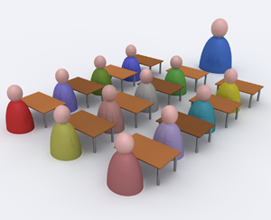
Staff
Non Teaching Staff | Existing
Technical | 06
Non Technical | 15

Slide 21
Students
Department has 697 students currently registered including UG, PG & Ph.D
Laboratories are supported by 50 senior M.Tech. students as teaching assistants

Slide 22
Research
Faculty members are provided partial reimbursement for participation in National/ International Conferences
Ph.D. programme has 59 research scholars currently registered

Slide 23
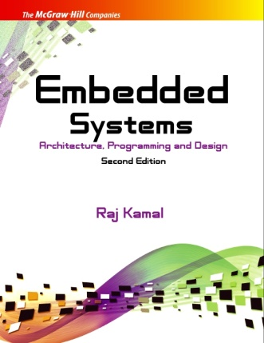
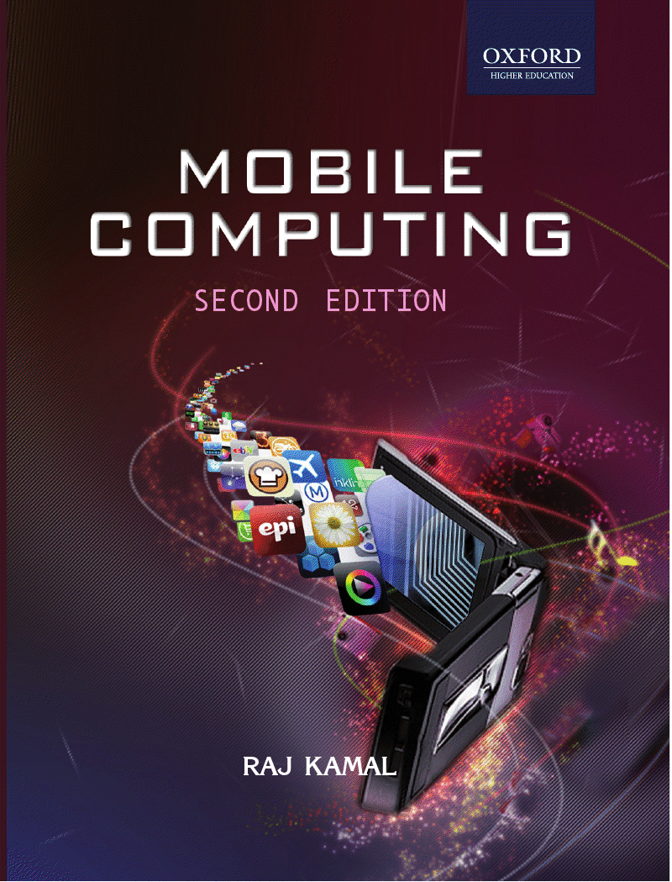
Book Publications
Dr. Rajkamal | 11 Books on Electronics and Computer Engineering Oxford University Press (1), McGraw-Hill (2), Schaum Series-McGraw-Hill (1), Pearson Education (4), National Publishers (4), USA - Korean Edition (1), Chinese Editions (2)
Dr. Ugrasen Suman | Software Engineering: Concepts & Practices Cengage Learning
Dr. Hemant Mehta | Getting Started with Oracle Public Cloud Packt Publishing

Slide 24
Research Publications
Name of the Faculty | Papers published (2008-13) | Max. Impact Factor/ Total Citations
Dr. Rajkamal | 31 | Upto 5 IF
Dr. M. Ingle | 21 | Upto 3 IF
Dr. S. Tanwani | 17 | Upto 3 IF
Dr. P. Kanungo | 15 | Upto 3 IF
Dr. D. S. Bhilare | 33 | Upto 3 IF
Dr. U. Suman | 48 | Upto 3 IF, 48 Citations
Ms. P. Saxena | 13 | Upto 3 IF
Ms. S. Masih | 05 | Upto 2 IF
Dr. Hemant Mehta | 11 | Upto 3, 48 Citations
Dr. Deepak Abhyankar | 09 | Upto 2 IF
Mr. Nitin Uikey | 03 | Upto 2 IF, 5 Citations
Total | 206

Slide 25
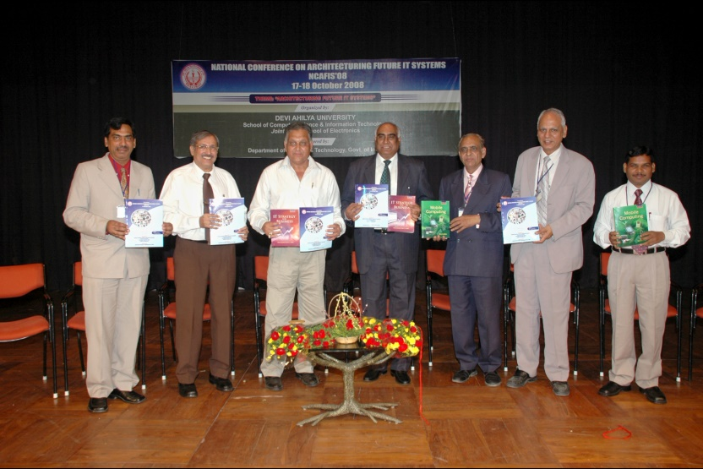
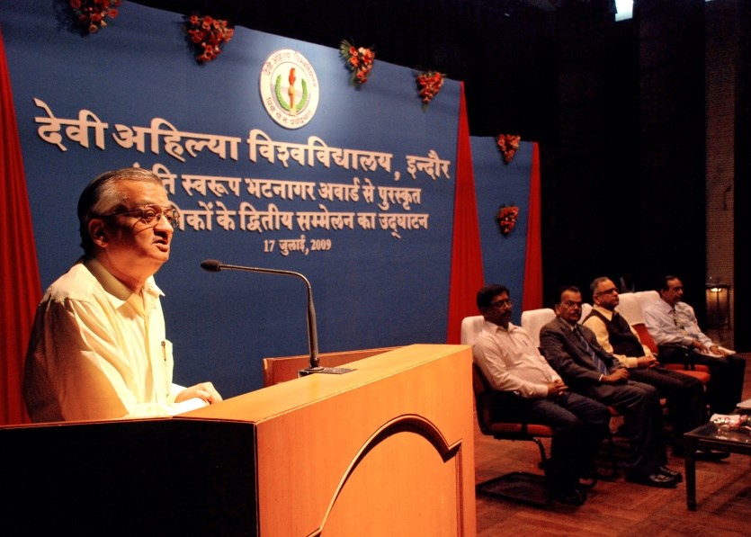
Conferences/ Workshops Organized
“National Conference on Architecturing Future IT Systems” 17- 18 Oct 2008, Sponsored by DST, New Delhi
“Modern Telecommunications Engineering” by Mr. Parag Mahajani, TechMahindra, Pune, Feb 12-13, 2009
“Software Component Technology” by Prof. T. V. Gopal, Anna University, Chennai, Mar 28, 2009
National Conference on “Shanti Swaroop Bhatnagar Award Winners” 17-19 Jul, 2009

Slide 26
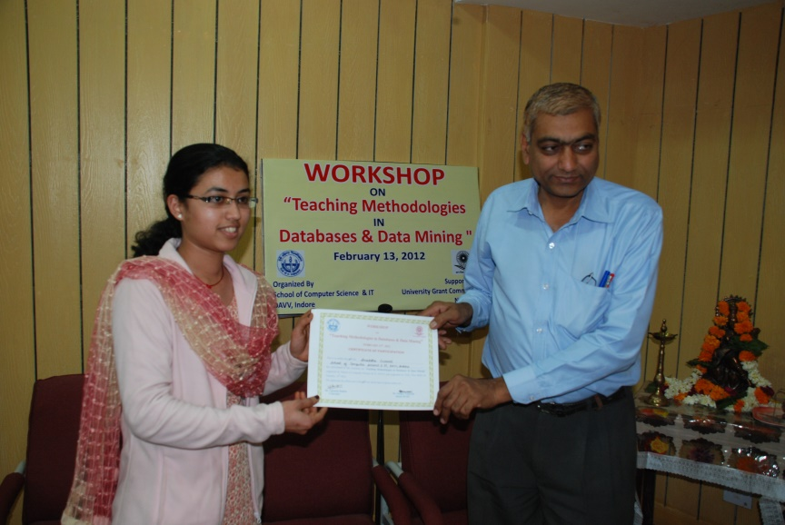
Conferences/ Workshops Organized
“Information Architecture” different phase of ADM was held on 4 Nov 2009 the full day workshop
“Career opportunities in CS & IT” by ICEIT- DAVV Indore, 1 Oct, 2010
“New directions in information and communication opportunities”, 15 Sept 2011
“Fun with Matlab”, by Mr. Ram Hablani on 22 Nov 2011
“Language Theory” by Dr. Maya Ingle on 25 Jan 2012
“Teaching Methodologies in Database & Data Mining” on 13 Feb, 2012

Slide 27
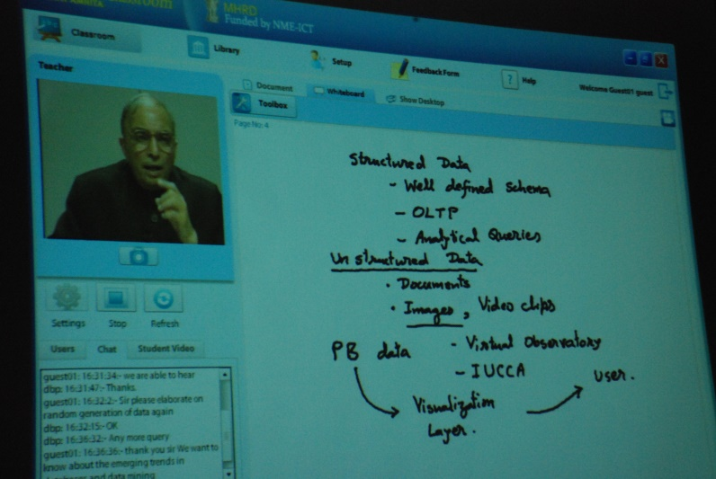
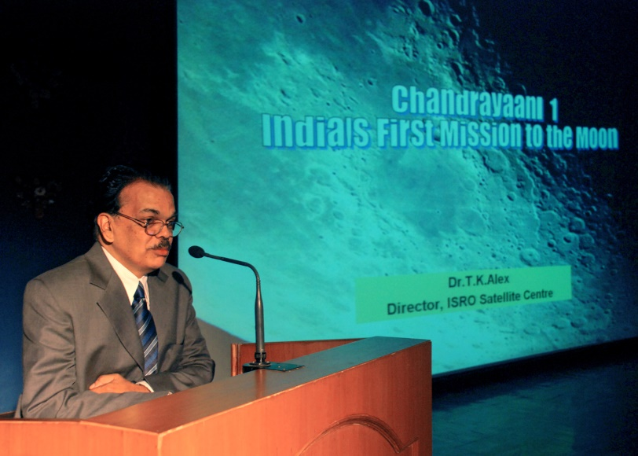
Conferences/ Workshops Organized
“Mobile Computing” on Mar 5, 2012
“Automated Testing Tools & Techniques” by Mr. Ashok Holani, 14 Apr, 2012
“Quality Issues in Academics, Paper Setting and Valuation” on 26 Sept, 2012
“Come Out of Shell” by Mr. Rajendra Deshmukh (Renowned Theatre artist) & his team on 3 Oct, 2012
“Text Mining” by Dr. Hemant Jain from U.S.A. for Ph.D. Scholars and M.Tech. Students

Slide 28
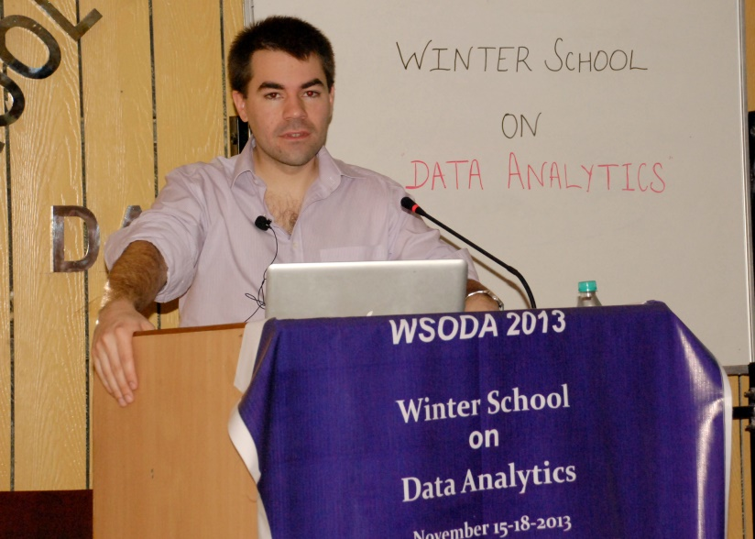
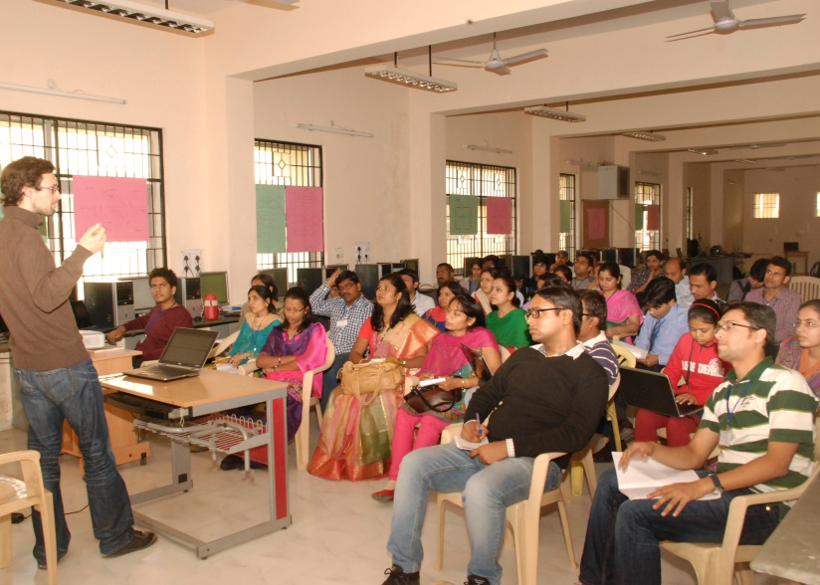
Conferences/ Workshops Organized
Microsoft Training Programme on “ICT for teachers“ other than IT background from 10 -19 Jun, 2013
Two days workshop on “Cloud Computing”, 6-7 Sept. 2013
Winter School on “Data Analytics”, by Indo German Max Plank Centre for Computer Science (IMPECS), 15 – 18 Nov, 2013

Slide 29
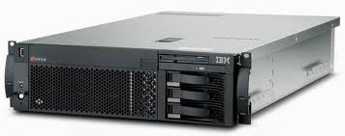
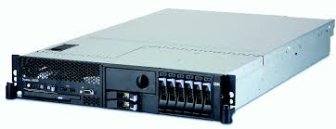
Projects
Database & Data Mining Lab with two IBM quad core servers
Supports 20 nodes for training and research in database & data mining
PSW Modeller & SQL Server
Unique state-of-art facility created under UGC-SAP grant

Slide 30
Interdepartmental Collaborations
School of Computer Science & IT, School of Electronics, and IET collaborate in running interdisciplinary courses
M.Tech. (Spatial Information Technology, Mobile Computing & Embedded Systems)

Slide 31
Collaborations
MOU with
Raja Ramanna Centre for Advanced Technology (RRCAT), Indore
National Research Centre for Soyabean (NRCS), Indore
I²IT, Pune
Informal collaboration with Dr. Hemant Jain, University of Wisconsin on Text Mining

Slide 32
Significant Achievements
Dr. Raj Kamal | Best paper | Indian Society of Agricultural Statistics 2012.
Dr. Hemant Mehta | Runner-up position in Outstanding Doctoral Dissertation Award | International conference on Soft Computing for Problem Solving (SocPros 2011) at IIT Roorkee.
Dr. Hemant Mehta | Nixi Fellowship worth 1000$ | 20th International WWW Conference, 2011 at Singapore.
Mr. Ajay Tiwari | Best paper | International Conference on TISC – 2010, Chennai.

Slide 33
Significant Achievements
Faculty | Responsibilities | Areas
Dr. Rajkamal Dr. S. Tanwani Dr. D. S. Bhilare Dr. Maya Ingle Dr. P. Kanungo Dr. U. Suman | Keynote Speaker Session Chair Paper Reviewer | Members of Steering Committee CSI Journals International Conferences E-Content generation under NMEICT project with support of EMRC, DAVV

Slide 34
Curriculum Design and Development
Subjects have well defined objectives
Class and lab assignments reflect the course objectives
Course files are prepared by every faculty
Reputed National/ International text/ reference books prescribed for the course
Course plan of the semester is based on feedback from previous semesters

Slide 35
Curriculum Design and Development
Assessment Workshop
Faculty Self Analysis of strength and weakness
Feedback from Students
Suggestions by Senior Faculties
Assessment Report used for Qualitative Improvement in next session

Slide 36
Curriculum Design and Development
Assessment workshop is held every six months
Feedback is analyzed and senior faculty members suggests for improvement
Special lectures are organized on various topics for quality enhancement
Teaching methods adopted by the faculty is based upon expected learning outcomes
Methods adopted are given in detailed course plan

Slide 37
Curriculum Design and Development
Guidance on teaching and improvement in the quality is supportive to attain program objectives
Departmental Academic Planning Committee monitors
Program objectives
Quality of assignments
Lab experiments and assignments
Question paper preparation

Slide 38
Curriculum Design and Development
Advanced training
Latest books for Library
Detailed course plan
Syllabus is reviewed by experts
Well equipped Laboratories
State-of-art computer systems
Student kits

Slide 39
Academic Flexibility
M.Tech. course specialized in three branches
Computer Science
Network Management & Information Security
Software Engineering & Information Architecture
Course curriculum offers a number of optional subjects
M.Tech. students can opt for subjects from
M.Tech. Future Studies
M.Tech. Energy and Environment
M.Tech. Embedded Systems
M.Tech. Mobile Computing
M.Tech. Spatial Information Technology

Slide 40
Student Admission Policy & Process
Ph.D.
Through Doctoral Entrance Test (DET)
M.Tech.
Through GATE and Departmental level counseling as seats allocated by AICTE
M.C.A.
Through Pre-MCA conducted by VYAPAM
BCA, M.Sc.(CS/IT), MBA (CM)
Through Common Entrance Test (CET) at University level

Slide 41
Student Admission Policy & Process
Entrance Test/ GATE
Selection on Merit
Orientation Program
Motivation Lectures
Special Training
For slow learners

Slide 42
Teaching – Learning & Evaluation
Teaching-Learning & Evaluation
External Evaluation
Internal Evaluation
Industry Projects, Experiments, Case Studies

Slide 43
Teaching – Learning & Evaluation
Strict adherence to Academic Calendar
Regularity in conduct of classes, labs and tutorials
Use of ICT in classrooms
Semester results and the answer copies are shown to the students to resolve grievances
Grades are finalized within two weeks at the end of each semester

Slide 44
Teaching – Learning & Evaluation
Students are encouraged to visit and study the lectures prepared by various prominent faculties
Quizzes, Seminars and mini projects
Mentors and Class Coordinators are appointed to deal with the student’s social and academic problems

Slide 45
Consultancy Services
Dr. S. Tanwani
Expert Member, MP Road Development Corporation
Expert Member, Technical Committee, State Bank of India
Consulted computer centre staff for online registration, enrolment, exam form filling, admit card print of more than 1,80,000 students
Dr. D. S. Bhilare
Expert Member, MP Road Development Corporation.
Active participation in examination system automation for the university as Head, Computer Centre
Expert Member, Indore Development Authority (IDA) for automating their processes using ERP

Slide 46
Patents
Dr. D. S. Bhilare
“Method for improved Quality of Service in terms of priority and security at Transport Layer of TCP/IP Internet Protocol Suite”, November 22, 2013, 3323/MUM/2013

Slide 47
Extension Activities
Seminar on “Tobacco and its harms” by Indian Dental Association and Dental College for UTD students
Seminar on “Women Health and Well Being” by Dr. Prerna Jain(Gynaecologist & FOGSI member) was organized on 21st Feb, 2013
The doctor gave an awareness lecture on women health issues and solved the health queries
About 250 girls from the department were benefitted
Seminar and demonstration on “Disaster Management” by Special Task Force, Gujarat

Slide 48
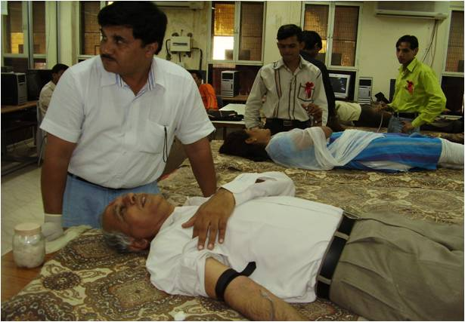
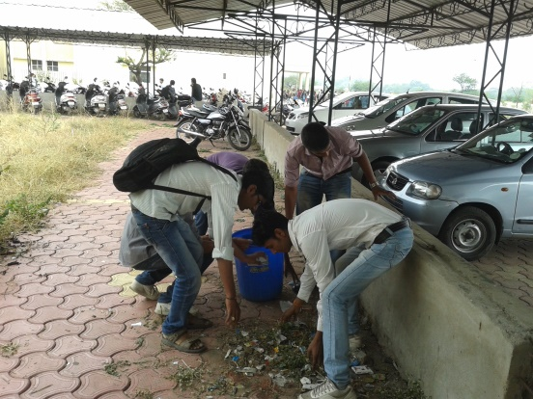
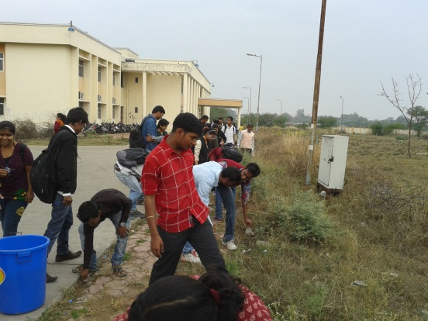
Extension Activities
Sensitization of faculty and students on its Institutional Social Responsibilities
Blood donation camp on every Teacher’s day
Distribution of items to needful people through the sanstha ‘Samarpana’
Tree plantation under green calendar
Khan river cleaning
Regular cleaning of polythene waste from the department and the surrounding

Slide 49
Research Extension
Research collaborations with three departments:
Raja Ramanna Centre for Advanced Technology (RRCAT), Indore.
National Research Centre For Soya Bean (NRCS) at Indore.
Department of Electronics and Telecommunication Engineering, New Delhi.
One Research Paper related to Quality Indicators for IT/Computer Center

Slide 50
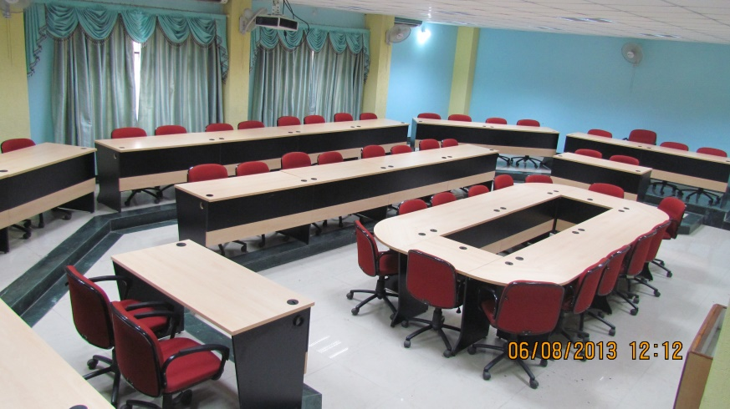
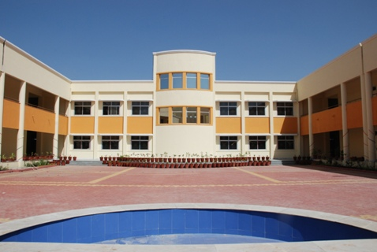
Academic Infrastructure
7860m² with both the administrative office and the academic block
Ten lecture rooms including two multimedia theatres
Faculty meeting hall
Ten computer laboratories
Department library

Slide 51
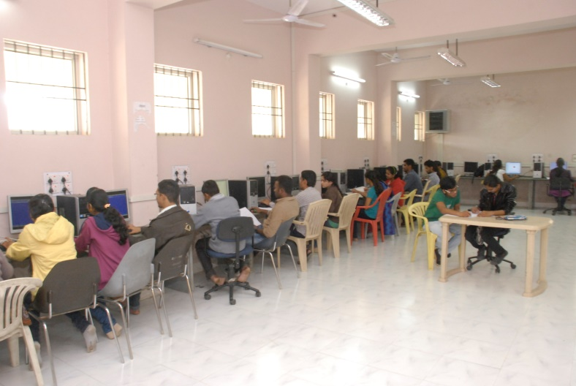
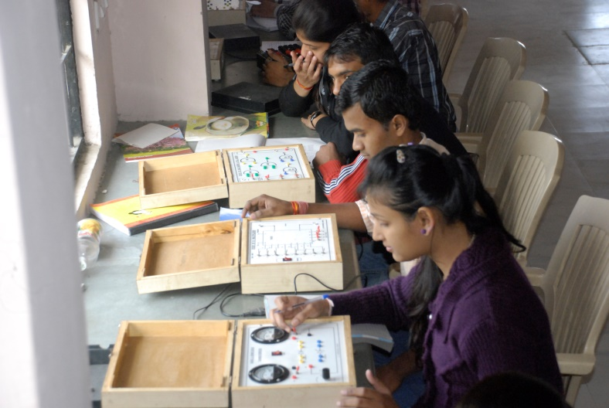
Learning Resources
Computer laboratories
Research Lab
Programming Lab
Database and Data Mining Lab
Networking Security Lab
E-Learning and Software Engineering Lab
Electronics Lab
Language Lab
ERP Lab
Equipped with 200 Computers

Slide 52
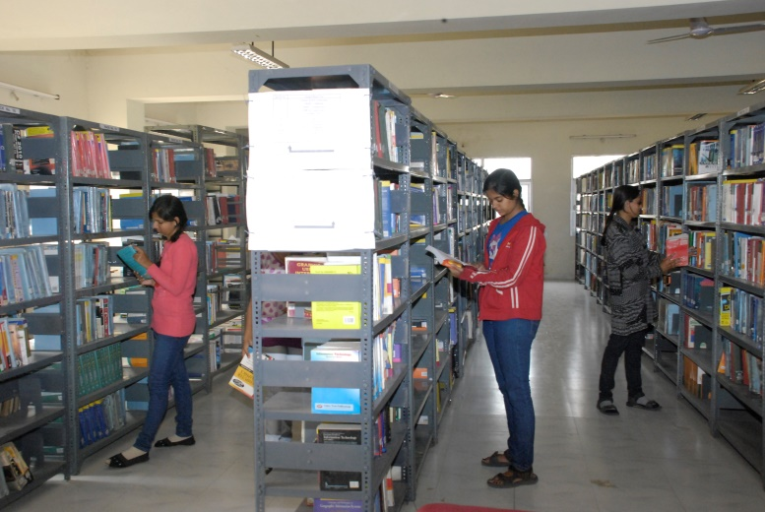
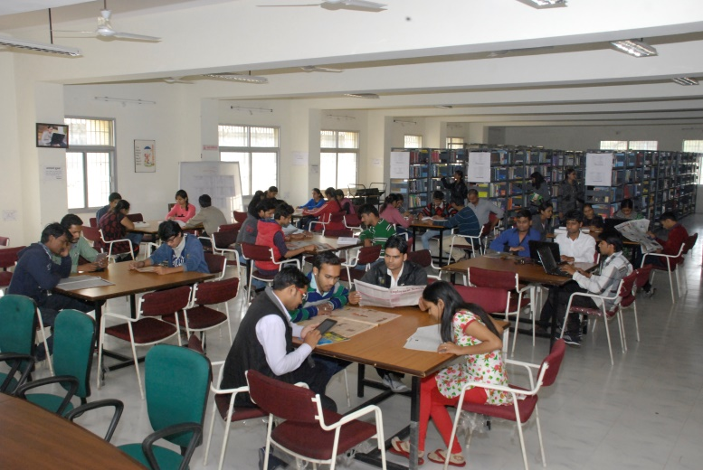
Learning Resources
Departmental Library
575.05 m²
Fully automated
16,053 text & reference books
1100 e-lecture CDs
16 computer magazines
5000 e-journals
Budget of 5 lacs/year
Procured 1243 books in the year 2012-13

Slide 53
Student Mentoring & Support
Mentors are assigned to a batch of 30 students
Responsible for resolving problems of the students
Personal enhancement and development schemes
Career counseling
Soft skill development
Career-path-identification
Orientation to well-being
Publication of updated prospectus and handbook
Online access
Course plans, Syllabus, Result, Fees payment etc.

Slide 54
Student Mentoring & Support
Scholarships/ free-ships given to the students
Scholarship and fee reimbursement to ST/ SC/ OBC through state government
Students taking admission in M.Tech. are GATE qualified and receive Rs. 8000/- per month as stipend from AICTE
Scholarship from minority cell available and few students receive financial assistance from the community they belong
Few students employed in the department under earn-while-learn scheme and receive financial support by the university

Slide 55
Student Mentoring & Support
Department provide partial/full financial support for students participation in
Competitions and conferences in India and abroad
University Health Centre
Skill development
Test results declared on time to identify the slow learner students
Performance enhancement for slow learner
Remedial classes are arranged
Extra problems/ exercises are assigned
Sports and extracurricular activities
Alumni Association
Anti-ragging committee

Slide 56
Student Progression
Several students are promoted from
UG PG (72%)
PG M.Phil. (20%)
PG Ph.D. (5%)
Ph.D. Post-Doctoral (1%)
Campus selection(50% eligible)
Other than campus recruitment (35%)
Qualify exams like UGC-CSIR-NET, UGC-NET, SLET, ATE / CAT / GRE / TOFEL / GMAT / Central / State services, Defense, Civil Services etc.
30 students are awarded Ph.D. (2008-2013)

Slide 57
Institutional Governance
Committees constituted
Academic Planning Committee
Departmental Research Committee
Placement Cell
Library and Laboratory Infrastructure Committee
Internal Quality Assurance Cell (IQAC)
Assessment & Research Committee
Industry Institute Relationship Cell
Exam and Result Committee
Disciplinary Committee
Grievance Redress Committee
Alumni Association
Anti- Ragging

Slide 58
Institutional Governance
HOD
Academic Planning
Departmental Research
Library and Laboratory Infrastructure
Internal Quality Assurance Cell
Assessment & Research
Industry Institute Relationship Cell
Exam and Result
Grievance and Disciplinary
Alumni Association
Mentors
Coordinators
Faculty
Staff
Students

Slide 59
Leadership & Management
Decisions taken by departmental committees
Designations like Chair, Co-chair, Conveners
Faculty – Student Participation
Purchasing of Lab equipment
Books and Magazines
Study material in Laboratory and Library
Class timing
Sports and activities
Research

Slide 60
Innovation & Best Practices
ICT enabled classrooms
Wi-Fi connectivity
Online Operations through MP Online for following tasks
Application form for entrance examination
Students Registration
Students Enrolment
Fee Collection
Exam Form Submission
Admit Card Printing
Updating of results on Portal

Slide 61
Innovation & Best Practices
Workshop on teaching pedagogies
Assessment workshop
Environment awareness and consciousness through campus cleaning and plantation
Regular conduct of expert lectures on
Personality shaping keeping students diversity in mind
Emerging trends in computer science
Democratic governance through various committees

Slide 62
Future Plans
Virtual classrooms and webinars for teaching-learning and research
Development of specialized laboratories
Image Processing
Network Security
Enriching existing laboratories
Generate e-resources for various computer related subjects under NMEICT project

Slide 64
Dr. Sanjay Tanwani Professor & Head, School of computer Science & IT, Devi Ahilya Vishwa Vidyalaya, Indore
Language Laboratory

Slide 65
Aim & Objectives
Established in 2011
Vision
To build a state-of-art facility to facilitate effective teaching, and research in various aspects of communications so as to develop reading, writing, communication, analytical & cognitive skills of students
Mission
Effectively using the state-of-art facility and help aspiring students to get training on practical aspects of communication

Slide 66
Objectives
Conduct practical classes for English speaking, reading, and writing, career, aptitude and overall personality development aspects of students for all University Teaching Department (UTD) students
Help and coordinate with Career and Guidance cell of the university to conduct classes of eminent experts in the area
Research on language barriers and its impact on learnability aspects
Coordinate with Industries and Placement cells and take feedback from stakeholders for sustained quality improvement

Slide 67
Infrastructure
23 HP Computers (Core2Due, 2 GB RAM)
UPS APC 600 VA
Headphones with integrated Microphone
Switches for network
Clarity Software Platform 30 user license
English, Career & Aptitude Lab software under procurement
Display Board

Slide 68
Usage by UTDs

Slide 69
Usage by UTDs

Slide 70
Usage by UTDs

Slide 71
English lab Features
English Lab
Communication Skills
Listening Skills
Vocabulary module
Phonetics
Conversations

Slide 72
Career Lab
Career Lab is a 300-hour self-learnable digital program
Career Lab
Fundamental Language
Communication
Listening
Personality Development
Entrepreneurship
Quizzes, Exercises, and Activities

Slide 73
Aptitude Lab
Provides abundant practice for students to:
Learn the strategies on how to approach the test.
Learn and practice short methods/techniques for solving the questions
And, more importantly, prepare for the company specific test pattern

Slide 74
Aptitude Test
Aptitude Test
Foundations
Practice Tests
Mock Tests
My Test
Report

